Slide 1
ACP3 Target Evaluation
Confidential 1

Slide 2
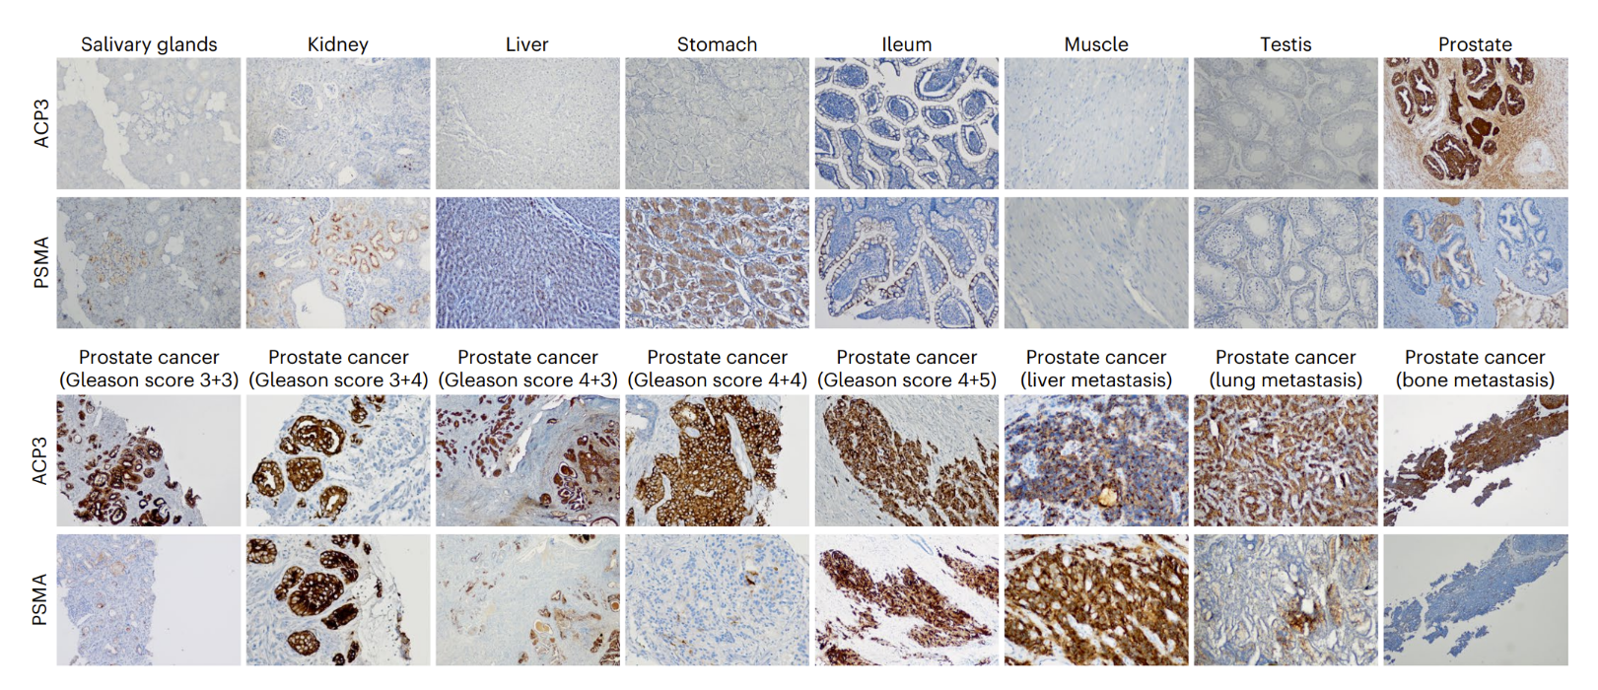
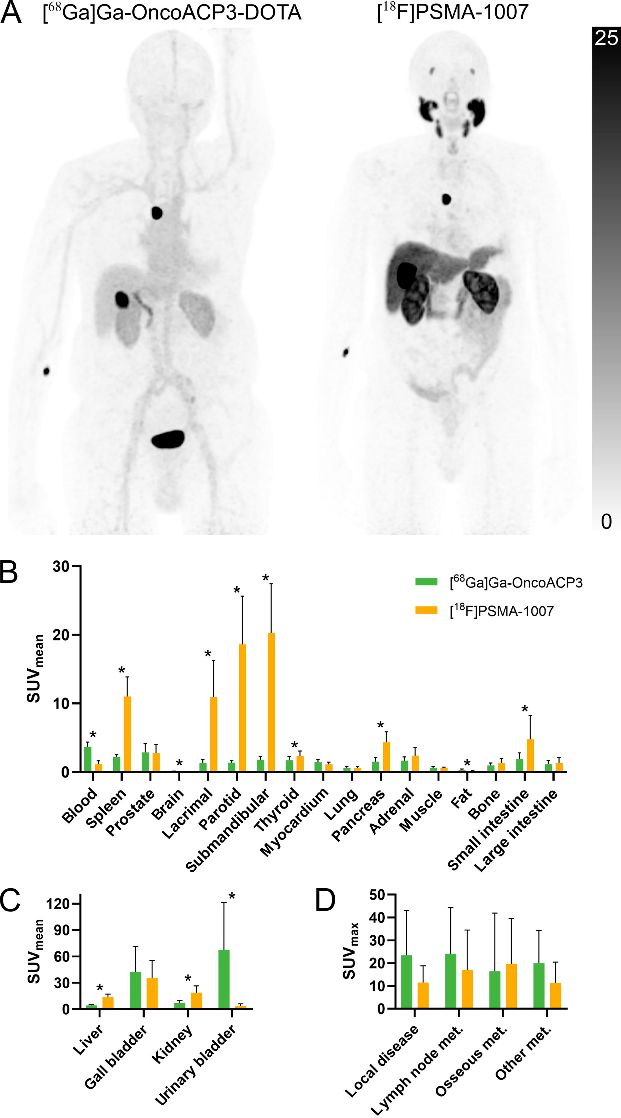
Prostate: ACP3 positivity across stages & risk levels creates broad RLT opportunity
Target Selection
Expression
Biology & Feasibility
Tumor-specific accessibility | ✓ | Tumor specific expression
Internalization | ✓ | Lysosomal targeting sequence
Secretion | ✓ | Secreted at lower levels than PSA
Ligandability | ✓ | Known active site & small molecule ligands
Expression in healthy tissue restricted to prostate vs. PSMA
95% pts are ACP3+ and expression is maintained through stages & metastases
Landscape
Imaging studies confirm ACP3 RLT uptake is higher in tumors and lower in healthy tissues compared to PSMA RLT
One competing ACP3 RLT, OncoACP3. BMS/Rayze. Ph 1.
Liability: Does not internalize, reduces efficacy
Greater uptake in bone metastasis
No salivary gland uptake
Less kidney, liver retention
Sego’s Approach
Modality | ACP3 targeted monomeric or bis-peptide RLT
Positioning | Initial positioning in mCPRC, with intent to expand beyond late-stage patients
Sources: Backhaus SNMMI Annual Meeting 2025 Georgiev Nat Biomed Eng 2025

Slide 3
ACP3 is an ideal RLT target with strong, consistent tumor expression
Biology
Phosphatase enzyme known as ACP3, PAP, PAcP and PSAP exists in two splice variants: cell surface transmembrane PAP (TM-PAP) and secreted PAP (sPAP). TM-PAP, contains a lysosomal internalization signal sequence, leading to constitutive internalization and recycling. sPAP is secreted, with a short biological half-life (relative to PSA), reducing off target toxicities.
Overexpressed in ~95% of prostate cancers, including PSMA-negative lesions. Little to no expression outside prostate; with expression in normal prostate not clinically relevant post radical therapy, with the potential for an excellent safety profile. Homogenously upregulated across primary, BCR and mCRPC, regardless of hormone sensitivity and Gleason score, while maintaining expression in metastases.
Targeted via small molecule inhibitors, e.g. OncoACP3, making it amenable to peptide targeting. There is significant room for improvement in uptake and retention of OncoACP3 as it does not internalize. Uro-oncologists are actively looking for treatments, especially RLT-based, for patients not amenable to PSMA-RLT.
~40–50% of mCRPC patients fail or are ineligible for PSMA-RLT. In contrast, ACP3 has high expression across all stages of prostate cancer. Due to very-prostate specific expression profile, there is opportunity for ACP3 based therapies to complete in mCPRC and move into earlier lines of therapy. Limited competition, only 1 known program: OncoACP3, licensed from Philochem to BMS/RayzeBio in 2025 for $350M+. PSMA-RLT revenues ~$2B, TAM predicted to be $4B; ACP3-RLT TAM could be >2x PSMA-RLT.
Expression
Feasibility
Landscape
Sego’s Opportunity
Design a Best-in-Class, peptide-based RLT that is internalized and released into the cell, driving higher uptake, longer retention & stronger efficacy against target that is consistently & selectively overexpressed in majority of PCa
Confidential 3

Slide 4
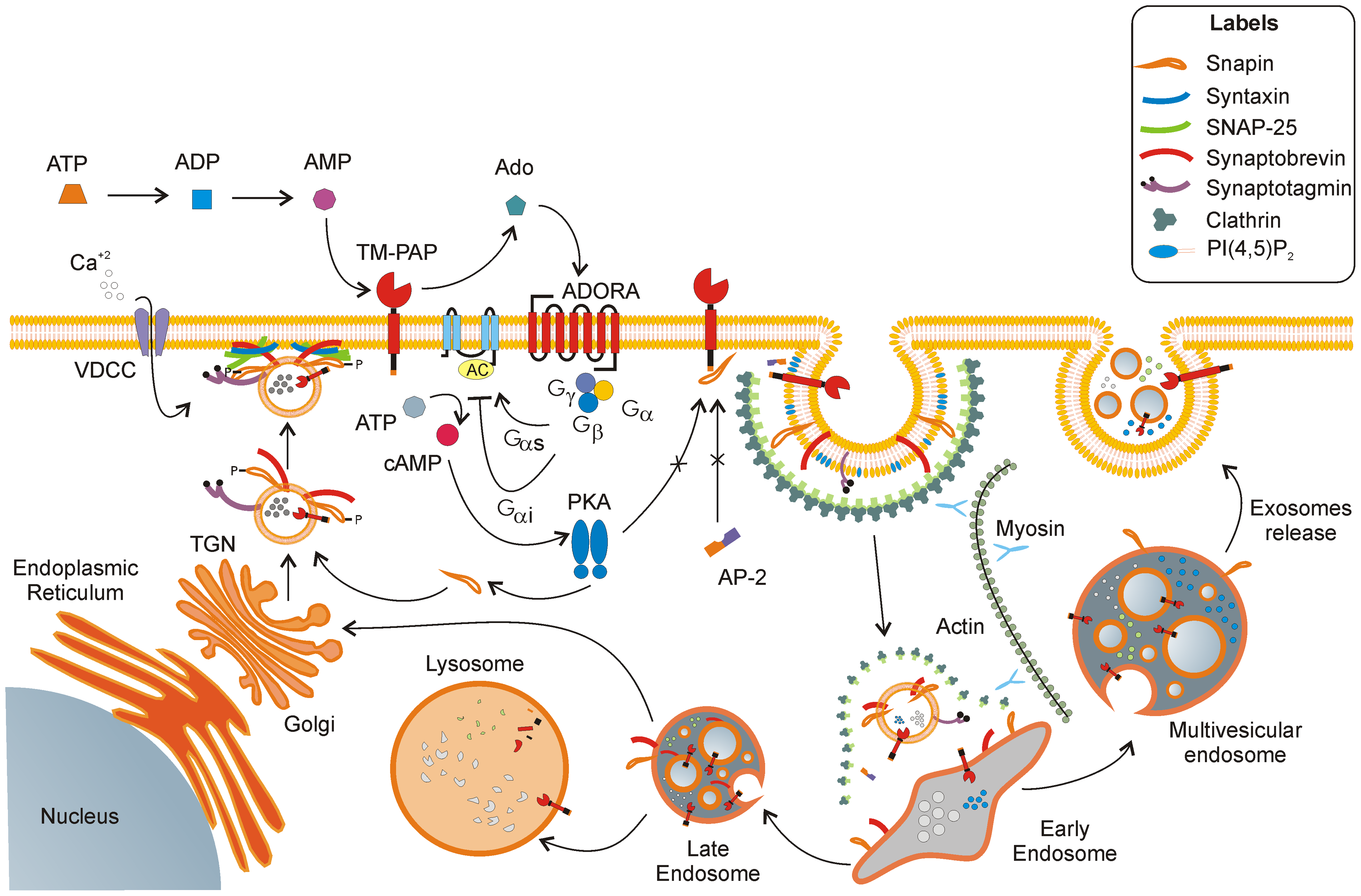
Biology
ACP3 (TM-PAP) is a cell surface protein phosphatase that is constitutively internalized into the cell
ACP3
Sources: Quintero et al Plos One 2013
Confidential 4

Slide 5
Expression
ACP3 expression is more homogenous than PSMA expression in PCa metastases
ACP3 healthy cell expression is restricted to prostate
ACP3 expression is maintained through prostate cancer progression and metastases
Sources: Georgiev Nat Biomed Eng 2025
Confidential 5

Slide 6
Expression
Imaging studies confirm ACP3 uptake is higher in tumors and lower in healthy tissues compared to PSMA
Sources: Backhaus SNMMI Annual Meeting 2025, Backhaus 2026
Confidential 6

Slide 7
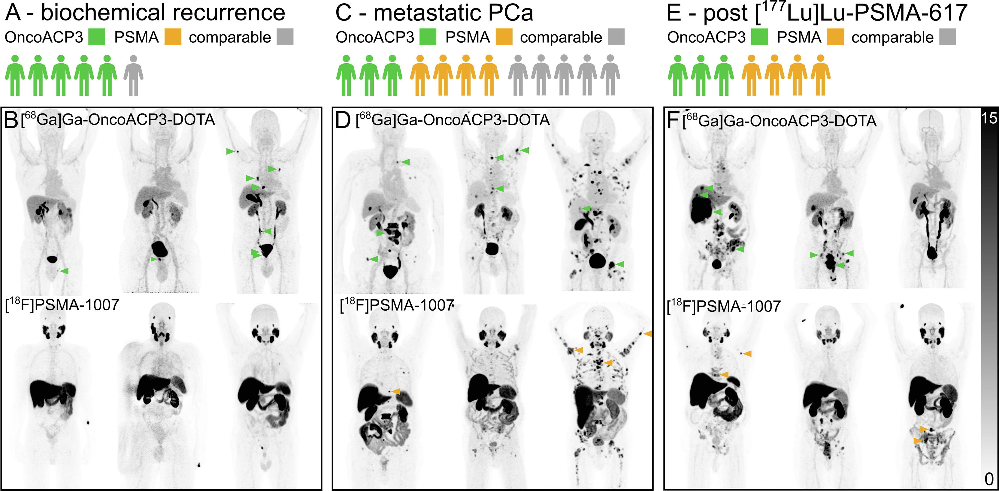

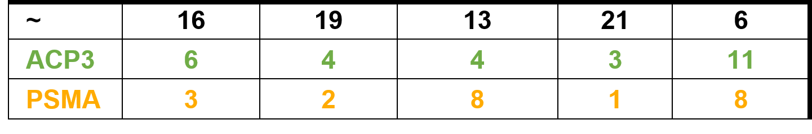
Expression
Emerging data suggest ACP3 can image & treat a distinct set of patients from PSMA, especially in earlier stages of disease
Imaging agent performance quantified by tumor location
~ = equivalent
Sources: Backhaus 2026
Confidential 7

Slide 8
Expression
Biology
ACP3 offers broader patient coverage & potential improved safety profile compared to PSMA
Feature | ACP3 | PSMA
Tumor positivity | ~95% (IHC) | ~85% (PET)
Expression in healthy tissue | Prostate, minimal expression elsewhere | Prostate, salivary glands, kidney, duodenum
Internalization | Yes (TM-PAP isoform), constitutive via intracellular lysosomal targeting domain | Yes, constitutively recycled and increased upon ligand binding
Shed / Secreted | Secreted (sPAP isoform) with short serum half-life | Detected in blood of cancer patients on circulating tumor cells and extracellular vesicles
Ligandability | Phosphatase active-site | Metallopeptidase active-site
Imaging data | High tumor contrast, minimal healthy tissue uptake | High tumor contrast, specific salivary gland, kidney, duodenum uptake
Sources: Tribian et al, Diagnostics 2023, Hupe et al Front Oncol 2018, Holzgreve et al JAMA Netw Open 2025, Backhaus et al SNMMI Annual Meeting 2025, Maes et al Int J Mol Sci 2024, Quintero et al PLoS One 2013
Confidential 8

Slide 9
Expression
ACP3 is a phosphatase that is expressed in prostate epithelial cells, overexpressed in prostate cancer cells, and negligibly expressed in other healthy tissues
Prostate Cancer Expression
Type | Method | Criteria | Value | Source
Protein | IHC | High percentage of strong staining (e.g., >10–30% of cancer cells showing moderate to strong positivity for target marker)​ | 90 to 97% of prostate cancer is positive with >70% moderate to strong staining. Staining intensity is high across grades | Tribian et al, Diagnostics 2023
mRNA | qPCR | Significant fold increase of ≥10 (0.05) | >100 to 1000-fold higher then normal tissue (excluding normal prostate) | Graddis et al, Int J Clin Exp Pathol 2011
Healthy Cell Expression
Type | Method | Criteria | Value | Source
Protein | IHC | Minimal or absent staining (ideally <1–10%; 0% preferred)​ | >95% of normal prostate is positive but <2–5% of cells or undetectable in other normal tissue | Graddis et al, Int J Clin Exp Pathol 2011
Confidential 9

Slide 10
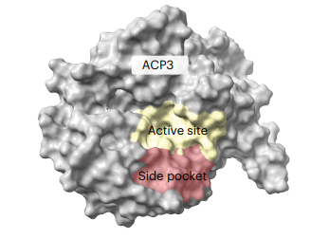
Biology
ACP3 (PAP) biology is ideal for radioligand targeting
Structure & Function
Transmembrane PAP Internalization
Secreted PAP
Two splice variants of ACP3:
Transmembrane PAP (TM-PAP): Type 1 transmembrane protein containing extracellular N-term phosphatase domain and C-terminal lysosomal targeting signal domain.
Secreted PAP (sPAP): Found in seminal fluid, involved in sperm motility via choline generation
Catalytically active form is a homodimer and functions as a protein phosphatase when active
TM-PAP is constitutively internalized (ligand independent) and has a specific c-terminal (intracellular facing) lysosomal targeting sequence.
The relationship between binding epitope and internalization is worth further exploration, as is the rate of internalization & recirculation
Quantities: Baseline 1ng/ml, early prostate cancer 1-5ng/ml, more advanced stages of PC range from 10-100ng/ml in blood.
Serum half-life: 1.1-2.6 hours
(Determined from patients undergoing transurethral resection (TUR-P)). Both renal filtration and liver metabolism are clearance routes based on the size of circulating ACP3.
While ACP3/PAP is shed into the blood, the short half life is beneficial and significantly reduces off target risks
ACP3 half-life is short in comparison to PSA, which has a 2-3 day half-life.
ACP3 Structure
Known small molecule binding sites
Sources: Muniyan Int J Mol Sci 2013, Wadstrom Urol Res 1985, Georgiev Nat Biomed Eng 2025, Quintero PloS One 2013, Quintero Cancer Research 2007, Sing NJPPP 2023
Confidential 10

Slide 11
Landscape
ACP3 positivity across stages & risk levels in PCa translates to multiple clinical opportunities, from mCRPC to earlier lines
There are 313K new cases, 35K deaths from prostate cancer per year in the US
Localized PCa
Systemic
Biochemical recurrence (BCR)
nmHSPC
Non-metastatic hormone sensitive
nmCRPC
Non-metastatic castration resistant
mCRPC
Metastatic castration resistant
99% 5yr survival
30% recurrence rate
~30% 5yr survival
Prevalent pts | 2.5-3M | 300-600K | 100K | 60-80K | 45-60K
PSMA Positive (PET) | ~50% | ~70-80% | ~85% | ~85% | 85-90%
ACP3 Positive (IHC) | >95% | ~95% |  |  | ~95%
ACP3-RLT could capture mCRPC and earlier stages of disease, based on high tumor and low off-tumor expression profile
PSMA-RLT $2B+ sales in mCRPC alone
Sources: Seer PC statistics, 2025, Scher Plos One 2015, ACS Prostate Cancer Statistics, Gultekin et al Urol J 2020, Holzgreve et al JAMA Netw Open 2025, Hotta et al JNM 2022, Tribian et al, Diagnostics 2023, Falagario Jama Netw Open 2023, Hird et al Clin Genitourin Cancer 2023
Confidential 11

Slide 12
Landscape
Example Target Product Profile for ACP3 RLT in mCRPC
Mechanism / Mode of Action | ACP3-targeted, peptide ligand conjugated to chelated ²²⁵Ac
Clinical Trial Design | Randomized, Phase 3, open-label study of ACP3-RLT to improve survival in mCPRC vs. standard of care
Indication / Target Patients | ACP3 positive, post-proctectomy patients with metastatic, castration resistant disease
Dosing Regimen & Administration | Intravenous infusion of ACP3-RLT for 4 doses, 4 weeks apart and 2 doses every six months following initial cycle until progression
Clinical Endpoints | Primary Endpoints Radiographic progression free survival (rPFS) Overall survival (OS)
Efficacy |  | ACP3 RLT | Pluvicto
 | Dosing Schedule | 4 doses. 4 weeks apart and 2 doses every 6 months until progression | 6 doses, every 6 weeks
 | OS | 25.8mo (HR 0.95) | 24.5mo
 | rPFS | 14.1mo (HR 0.85) | 12mo
 | QOL (FACT-P) | >8mo | 7.5mo
Safety / Tolerability | Grade ≥3 TEAEs All grades dry mouth All grades anemia (Grade ≥3) All grades thrombocytopenia (Grade ≥3) | 36% <5% <27.3% <10% | 36% 59.5% 27.3% (6.2%) 10% (2%)
Confidential 12

Slide 13
Opportunity
Sego’s differentiated approach to ACP3 vs OncoACP3
 | BMS/Rayze/Philochem | Sego’s Approaches
 | OncoACP3 | Internalized cyclic peptide | Bis-ACP3 Approach
Modality | Small-Molecule | Cyclic Peptide | Peptide dimer (2x peptides for ACP3)
Isotope | ¹⁷⁷Lu | ²²⁵Ac or ¹⁶¹Tb | ²²⁵Ac or ¹⁶¹Tb
Internalization | “Not observed” | Select for internalizing peptides to utilize increased cytotoxicity with internalized alpha and auger emitters | Both internalizing and non internalizing peptides would be explored
Disadvantage | Not delivered into cell, not suitable for emerging, more potent alpha or auger emitter isotopes. Risk of off target effects without internalization | Risk of not identifying a high affinity, internalizing peptide | Larger molecule size, potential kidney metabolite retention
Advantage | First-in-class | Improved tumor retention & ability to localize isotope intracellularly. Ability to leverage more cytotoxic isotopes with internalization. | Improved K_{D} and tumor uptake/retention due to bis-peptide design, hypothetical better efficacy and potential lower doses required. May allow for use of lower affinity monomeric peptide.
Sources: Georgiev Nat Biomed Eng 2025
Confidential 13

